Slide 1
Data Analysis of Traffic Accidents
By
ABDUS SAMI

Slide 2
Introduction
The science and technology has changed the world transportation sector.
Now people love to travel in cars intercity or long distances with greater comfort and speed.
However, the problem of car accidents are still suffer us a lot.
The USA Highway and Traffic Administration department said there is a loss of about 900 billion dollars in a year due to car accidents besides loss precious human lives.
The USA Highway and Traffic Administration department said there is a loss of about 900 billion dollars in a year due to car accidents besides loss precious human lives.
In 2017, Washington traffic fatalities increased by 5.4 percent (from 536 to 565).

Slide 3
Introduction
Nationally, traffic deaths remained largely unchanged, decreasing less than half a percent and leveling off the steepest two-year increase in 50 years.
With the rebounding economy and increases in vehicle miles traveled, Washington must require to implement new innovations and modern data analyzation to realize its vision of zero traffic fatalities and serious injuries.
This Data Science Project aims to analyze the traffic accidents data and find the factors that caused these accidents.
The main stake holders involved in this are 1- Public Development Authority Seattle 2- Drivers

Slide 4
Data
The latest accident dataset of accidents has been taken from the city of Seattle, Washington from 2004 to 2020.
The data contains accidents details such as time, condition of weather, location, severity, junction type, road conditions, speeding etc.
There are more than 30 features in the dataset. The data set used can be downloaded from there.
The propose model will try to predict an accident severity, the feature accident severity is in the form of 1( Car or property damage) and 2 (physical injury) that are encoded into 0 (property damage only) and 1( Physical Injury) using One hot Encoder.

Slide 5
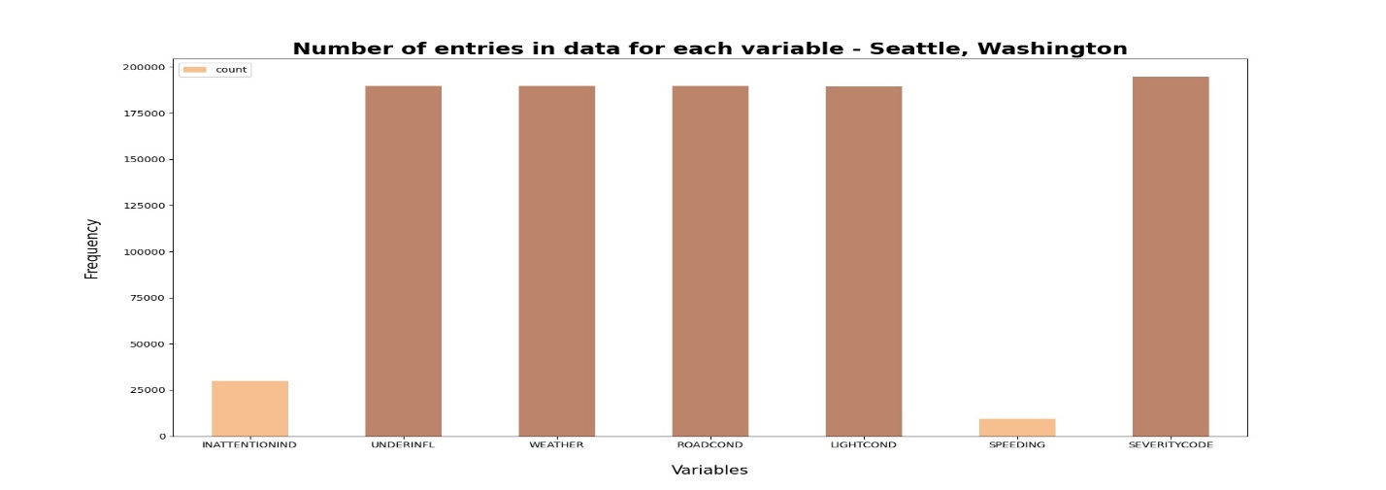
Data

Slide 6
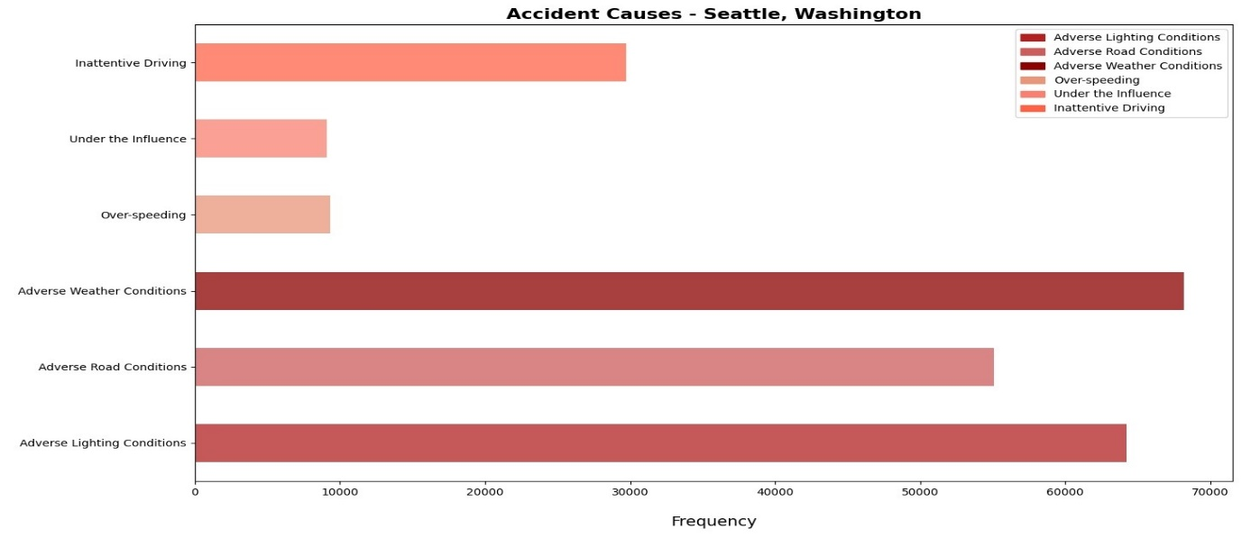
Data

Slide 7
Methodology
Different machine learning models are used for different purposes.
Logistic Regression is used to model binary dependent variables.
The Decision Tree is used break down data set into smaller subset while at the same time tree is developed gradually.
K-NN is used for the similarity measurement among the variables.

Slide 8
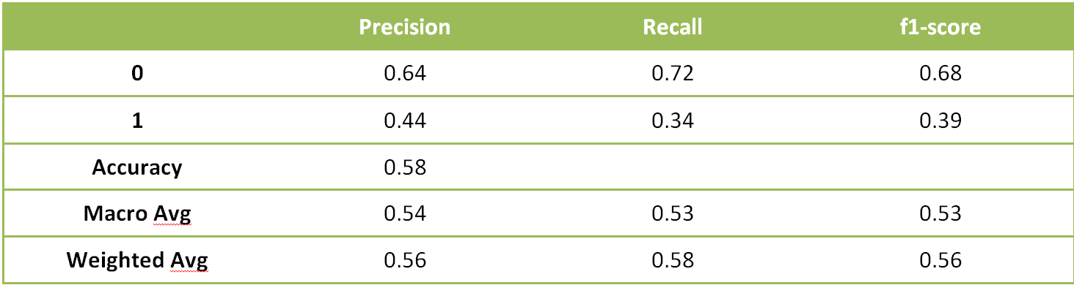
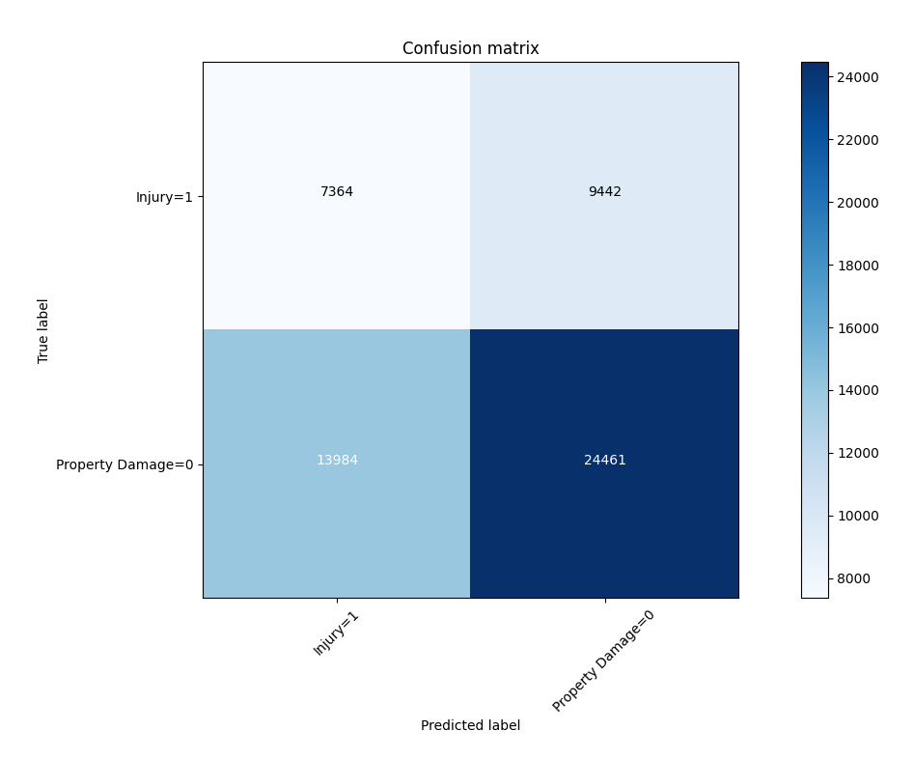
Results
Decision Tree Model:

Slide 9
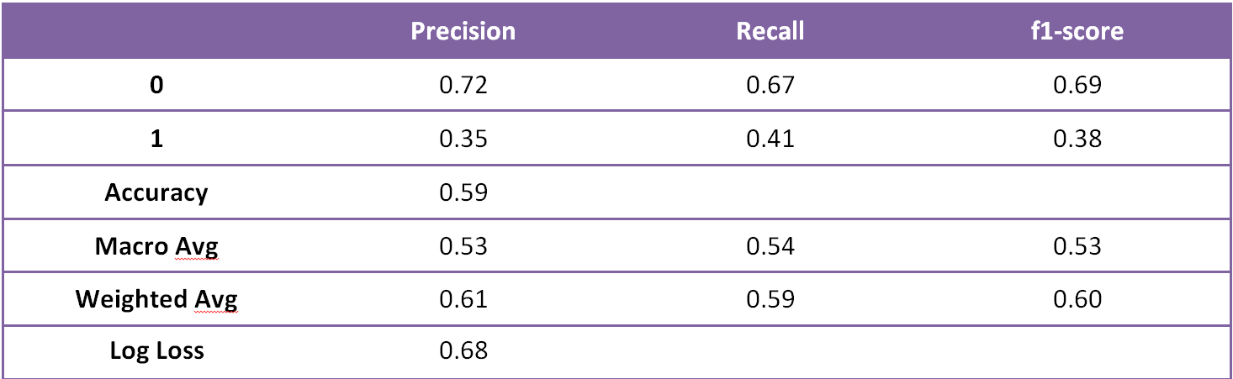
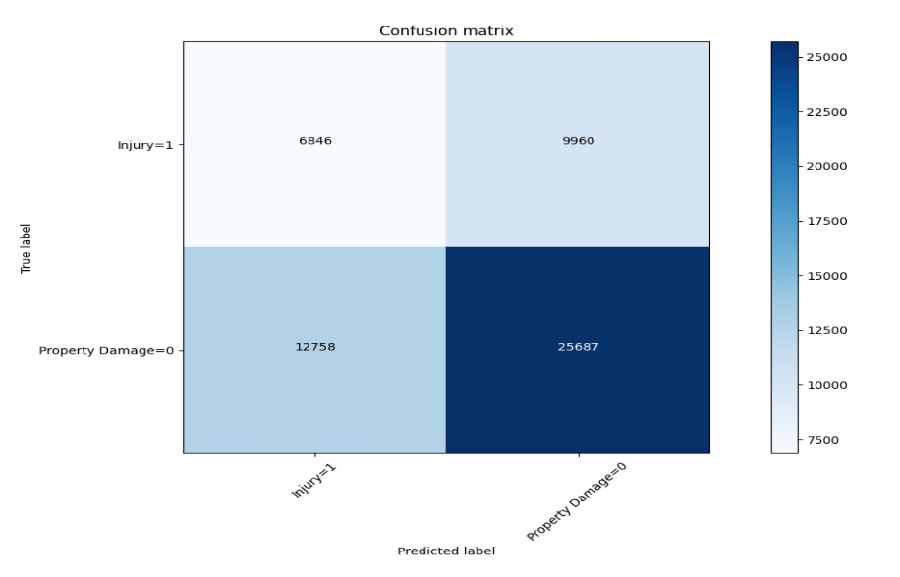
Results
Logistic Regression Model

Slide 10
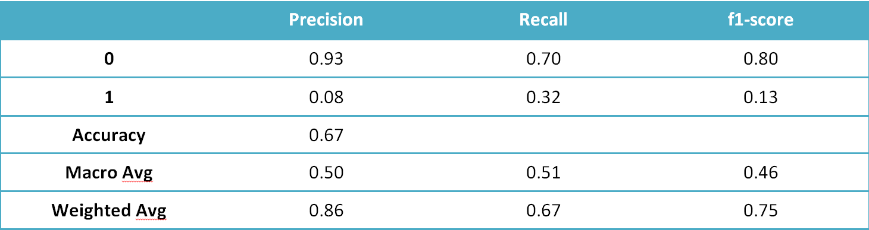
Results
K-Nearest Neighbor

Slide 11
Conclusion
1-The F1 score is highest for K-NN at 0.75 however it performs poor on Precision and Recall.
2-The Decision Tree Model having 0.56 F1 score and balanced precision and recall for 0 and 1.
3- The Logistic Regression F1 score 0.6 and more balanced precision and recall for 0 and 1.
So the Decision Tree and Logistics Regression shows better performance and can be used for the purpose of best fit model.

Slide 12
Recommendation
Road or light conditions were not ideal, if these main two factors can be improved the accidents will surely decreased.
The Car driver must be informed time to time about the conditions of road, lights, weather and specific locations of roads where accidents are most.
This data analyzation can be used to help drivers for information and avoid accidents in future.

